Slide 1

Don’t Wine About It
An exploratory investigation into the numbers behind some of the best wines in the world…and some of the worst
This Photo by Unknown Author is licensed under CC BY-SA

Slide 2
Question
Where is the best wine produced for the most popular varieties of wine?

Slide 3
Explanation about our dataset
The data set included:
Country - The country that the wine is from
Title – The title of the wine review, which often contains the vintage if you're interested in extracting that feature
Description
Designation - The vineyard within the winery where the grapes that made the wine are from
Points - The number of points Wine Enthusiast rated the wine on a scale of 1-100
Price - The cost for a bottle of the wine
Province - The province or state that the wine is from
Variety - The type of grapes used to make the wine (ie Pinot Noir)
https://www.kaggle.com/zynicide/wine-reviews

Slide 4
What does the point system mean?
95-100 Classic: a great wine
90-94 Outstanding: a wine of superior character and style
85-89 Very good: a wine with special qualities
80-84 Good: a solid, well-made wine
75-79 Mediocre: a drinkable wine that may have minor flaws
50-74 Not recommended
According to Wine Spectator(https://www.winespectator.com/display/show/id/scoring-scale). A revered website in the whole wine world.

Slide 5

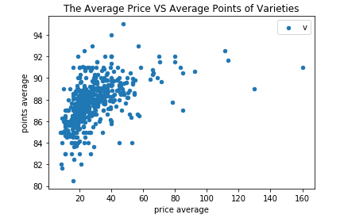

Slide 6
The Top 10 Varieties of Wine
index | variety | Count
0 | Pinot Noir | 11693
1 | Chardonnay | 10070
2 | Cabernet Sauvignon | 8284
3 | Red Blend | 7537
4 | Bordeaux-style Red Blend | 5123
5 | Syrah | 3617
6 | Sauvignon Blanc | 3177
7 | Rosé | 2839
8 | Zinfandel | 2707
9 | Merlot | 2630

Slide 7
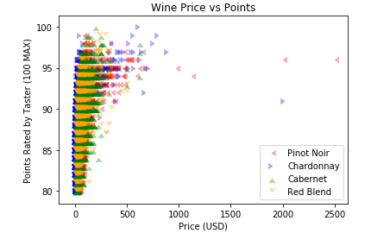

Slide 8
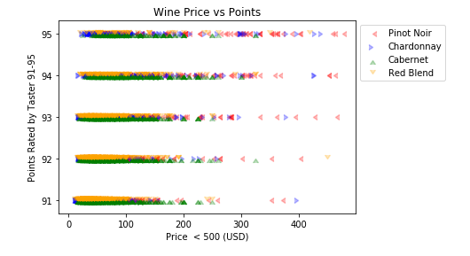

Slide 9
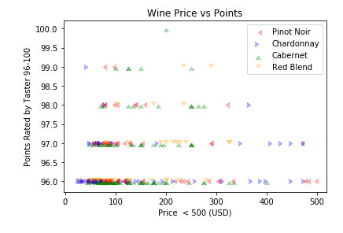

Slide 10
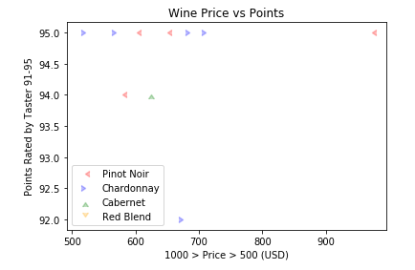

Slide 11
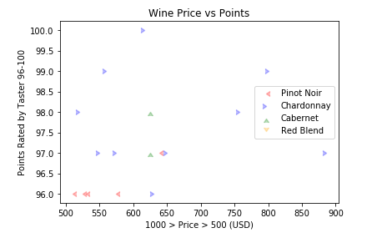

Slide 12
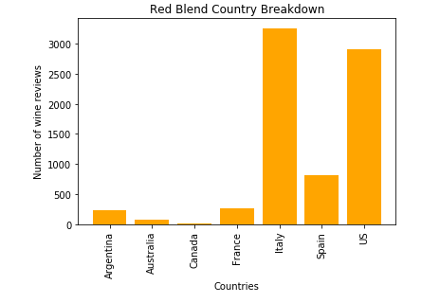
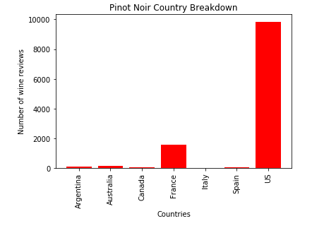
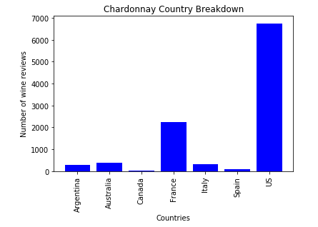
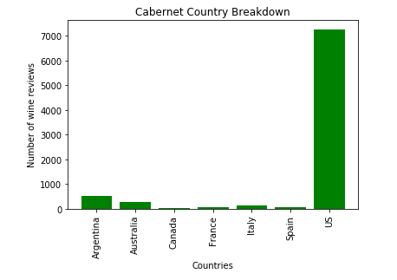
Best valued wine.
Notes:
This is going to be the value graph or graphs.

Slide 13
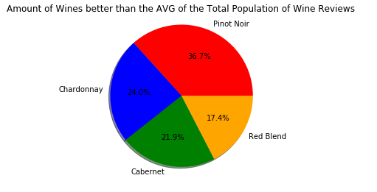

Slide 14
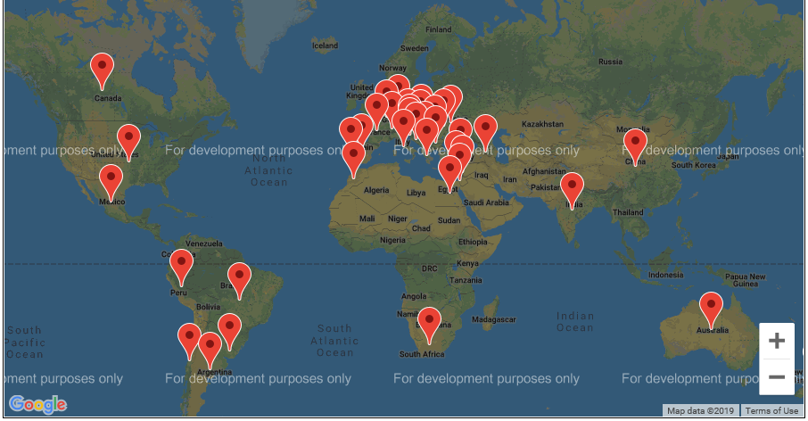
Where is the wine coming from?
Notes:
This will be the graphs which show where the most wines from our data come from.

Slide 15
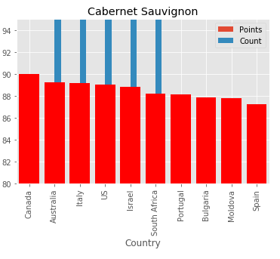
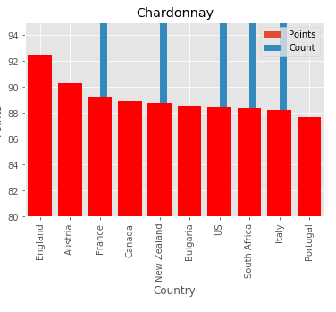
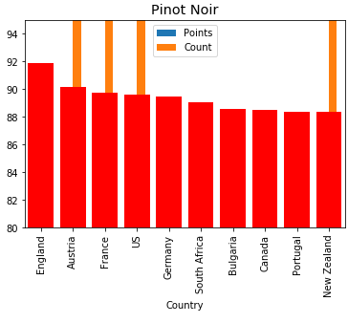
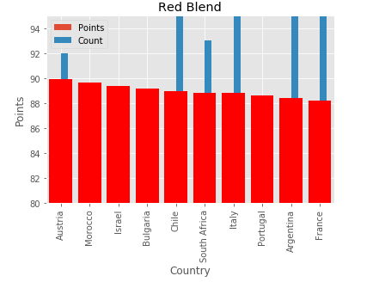
.

Slide 16
Conclusion
In conclusion, great wine can come from all over. The US makes it clear that just because a country makes a whole lot of wine, does not mean the product is any better than that of other countries. In fact, the US tends to have worse scores than other countries. Our graphs further demonstrate this as about half of the highest rated wines have over 80 wines produced. Interestingly, England has about 74 wines in our dataset yet is constantly rated highly in comparison with other countries. One surprise of the data came when France didn’t dominate the ratings. It is 3rd for Chardonnay and barely makes the top Red Blends. Instead countries like bulgaria which has about 15-30 entries dominates as it makes the top ten for all of our types of wine. So where should you get your next bottle from? Our data says to try out an English, Austrian, or even a Bulgarian bottle as its very likely, regardless of the type you choose, that you will enjoy it.
Notes:
In conclusion, great wine can come from all over. The US makes it clear that just because a country makes a whole lot of wine, does not mean the product is any better than that of other countries. In fact, the US tends to have worse scores than other countries. Our graphs further demonstrate this as about half of the highest rated wines have over 80 wines produced. Interestingly, England has about 74 wines in our dataset yet is constantly rated highly in comparison with other countries. One surprise of the data came when France didn’t dominate the ratings. It is 3rd for Chardonnay and barely makes the top Red Blends. Instead countries like bulgaria which has about 15-30 entries dominates as it makes the top ten for all of our types of wine. So where should you get your next bottle from? Our data says to try out an English, Austrian, or even a Bulgarian bottle as its very likely, regardless of the type you choose, that you will enjoy it.

